Slide 1

Physician Burnout at MVU Health
Team 12
Cole Moorcroft, Veronica Moore, Ethan Poris, Tian Tang, Carol Zhang
Notes:
Good afternoon everyone, and welcome to our presentation discussing physician burnout at MVU Health.
Presenting to you today, we have myself Veronica Moore, Cole Moorcroft, Ethan Poris, Tian Tang and Carol Zhang.
10 sec

Slide 2


Executive Summary
Cause
Problem
Hospital inefficiency, underuse of mental health resources, and COVID-19
Recommendation
Physician burnout leading to poor mental health
Reallocation of funding, virtual mental health resources, pandemic preparation
Notes:
In our presentation, we will be addressing the problem at hand, its causes, and our recommendation moving forward. Physician burnout is leading to deteriorating mental health in our organization due to hospital inefficiency, underuse of mental health resources, and the ongoing pandemic. Our recommendation will involve a reallocation of funding and employees, implementation of virtual mental health resources, and prepping the hospital resources in anticipation of increased COVID-19 cases.
30 sec

Slide 3
The Problem at MVU Health
Deteriorating Mental Health of Health Care Providers
Notes:
What is the problem the health care providers at MVU health facing right now? To simply put it, they’re stressed. And this continued stress is deteriorating the mental health of the physicians
10 sec

Slide 4




Long-term Effects of Stress
BURNOUT
Negative Impact on Mental Health and Well-being
STRESS
COST OF BURNOUT
$5,168,000+
Prolonged stress and work dissatisfaction
CONSEQUENCES
Decreased productivity, increased medical errors, negative organizational outcome
Notes:
So what are the consequences of stress?
Overtime, the High rates work dissatisfaction and prolonged stress leads to physician burnout
This burnout negatively impacts their mental health and well-being and subsequently leads to visible consequences
Such as Decreased productivity, increased medical errors which all contribute to an overall negative organizational outcome
Financial ramifications of burnout at MVU health are estimated to be Upwards of 5 million dollars annually, and this cost does not include burnout and turnover in other health care provider staff as well, nor malpractice suits and decreased clinical hours
5168000
Upwards of 5 million dollars annually, and this cost does not include
40 sec

Slide 5
Factors Contributing to Physician Stress
Inefficient EMR System Effective team-based care model too expensive to systemically implement
COVID-19 Pandemic Increased occupational risk and uncertainty of future events
Productivity-based Compensation Increased workload and pressure
Increased Exposure to Death
Feelings of helplessness and failure
Underutilized Wellness Services Stigmatization and fear of license loss
Social-Distancing Measures
Social isolation and disruption of normal day-to-day activities
Notes:
What factors are contributing to the high stress levels at MVU
Inefficient electronic medical record system and despite developing an effective team-based care model to decrease physician pajama time, we lack the funding to roll out this model all clinics
Productivity-based compensation model results in increased pressure in doctors
Currently wellness services and mental health resources are underutilized due to stigmatization and fear of license loss due to confidentiality concerns
The covid-19 pandemic is additionally increasing the mental load of our physicians
There is increased occupational risk and exposure to death and social distancing measures are upheaving normal day to day life
Theres increased occupational risk including an increased exposure to death. This can exacerbate feelings of helplessness and failure in the workplace
social-distancing measures can also be attributing to lower hospital moral, social isolation is causing a massive change in day-to-day life and feelings of uncertainty could lead to additional mental stress load
60 sec

Slide 6
Action Plan
ASSESS
ANTICIPATE
Estimate extent of burnout and budget accordingly
Take preemptive measures to ensure COVID-19 readiness
1
2
3
4
REFORM
PREVENT
Reallocate funding from existing, underutilized services
Implement creative solutions to alleviate physician overwork
Notes:
We’ve devised a four step Action Plan to deal with all the aforementioned issues
Step 1 is to assess the extent of the damage burnout is causing in our organization, and use that information to budget resources to fix it
Step 2 is then to reallocate resources from our current, underutilized, services into new, more modern, safer services
Step 3 is to prep ourselves for any influx of Covid cases to ease staff’s worries over getting overwhelmed
Finally, step 4 is to implement new and innovative solutions to growing feelings of being overworked
ASSESS
Need for intervention
ADDRESS and MITIGATE
Current stressors
through mental health resources and decreasing stressors as much as possible
PREVENT
Increase covid-19 preparedness
In order to effectively address the current problems regarding physician burnout, we have to assess the situation unique to our hospital so that we can reform our mental health resources to allocate our funding accordingly
Additionally we have to ANTICIPATE the consequences of COVID 19 on health care provider mental health and look ahead and prevent future burnout through longer tterm solutions

Slide 7


Assess Need
Burnout is lost revenue and survey is free opportunity to understand its impact
01
Understand Burnout Rates
Survey healthcare providers
02
After survey, can estimate financial impact
Calculate Cost
03
Allocate Resources
Financial cost of burnout then informs budget to fix it
Notes:
So, back to Step 1 – Assess
As we’ve discussed, burnout isn’t only bad for our doctors, it’s bad for our bottom line. One executive commented “we know it’s bad, why do we need a survey to tell us?” Well, if we don’t know how bad burnout is, we don’t know its full impact on the balance sheet, and the survey is a free way to get some numbers on it.
Once we have the numbers on burnout, we can use those to estimate how much it’s costing us
Finally, we can come up with a budget to decrease burnout based on its estimated cost and how much we feel we can realistically reduce it
Assess current burnout levels to determine annual cost of burnout – this can inform how much we spend on our plan
Nurses survey

Slide 8

Reform Existing Resources
Outsource Wellness
Switch to external mental health providers increases doctor privacy and decreases fear of danger to licenses
Transition Online
Makes wellness resources convenient to access and COVID-safe
Credit System
Ensure all physicians address mental health and mindfulness and reduce stigma of treatment
Notes:
After we’ve assessed the impact of burnout and how much we can invest in solving it, we can turn to our actual solutions to normalize seeking help in the culture
The major issues doctors cite not to use our existing in-house mental services are stigma and fear of professional repercussions
To address the fear of repercussions, we’ve decided we should switch from providing wellness resources ourselves to provide it through an external provider. This will increase doctors’ privacy and alleviate one barrier to seeking help
To further increase privacy and safety, we also want to transition most our wellness services to online. This will make the services more convenient to use, more Covid-friendly, and even more private than the move to the external provider does alone
Finally, to address stigma, we want to implement a credit system wherein all doctors have to engage in a minimum amount of time in the wellness services per quarter. It’ll be a small amount of time, but those who want to do more, can, and the intent is to get physicians who otherwise would not have reached out to get much-needed help
To address stigma, we’ve devised a credit system whereby all physicians are provided an array of wellness activities they can participate in, and all doctors must do a minimum amount on a quarterly basis. There may be some who drag their feet on the initiative, but the intent is for those doctors who wanted but otherwise would not have received needed care will now have no

Slide 9

Anticipate COVID-19 Influx
Build inventory of PPE and medical devices to mitigate risk of working without appropriate protection
Transition Care to E-Health
Phase outpatient and non-essential services to telehealth to ensure continuity of care
Ensure Equipment Readiness
Notes:
Beyond improving our current wellness services, we believe that it’s essential to take a preventative approach to healthcare worker stress related to the pandemic. Though we currently have a low caseload of COVID-19 patients, nationwide trends are not encouraging, and regardless of how robust our support services are, their efficacy and cost-effectiveness will be limited if we do not address the root causes of stress.
Therefore, we recommend using this time of relative calm as an opportunity, proactively increasing our capacity to deal with COVID-19. We should begin our transition to e-health for outpatient and non-essential in-person services early, such that we can ensure continuity of care. We also recommend building our inventory of PPE and medical devices early, to ensure equipment readiness before, rather than during a crisis. Our workers should not have to deal with the added burden of working without adequate protection, on top of the pandemic.
The US government has funds to hospitals in light of COVID-19, and these are funds we should take full advantage of to mitigate future healthcare worker burnout and the associated costs to our organisational and financial health.

Slide 10



Explore Long-Term Solutions
Clerks are out of work
Relieve physician workload
Medical students who cannot learn in clinic due to COVID-19 restrictions are a valuable resource
Clerks who cannot participate in their clinical rotations can relieve load of scribing and EMR duties
Train clerks in EMR
Provide job-relevant experience and increase preparedness after graduation
Notes:
Long-term, we must also be cognizant of how the future generation of doctors will also be impacted by this pandemic. COVID restrictions on the number of personnel allowed in clinic vastly decrease the number of learning opportunities for medical students undergoing clinical rotations, and units hit particularly hard by COVID may not be permitting clerkships at all. This constitutes a large body of highly-trained individuals who are sitting idle.
Since 2018, medical students can legally participate in the official medical documentation process. We believe that training clerks who cannot participate in their usual clinical rotations as scribes and in EMR is a valuable opportunity. The benefits are twofold – clinicians will have their documentation burden and burnout reduced, and clerks will be given valuable experience (in the pandemic and beyond) that increases their preparedness to employ EMR in their practice when they graduate.
This plan achieves much of the benefits of the team model proven to work in primary care while incurring fewer of these costs, since we can fund through grants.
Costs to train clerks can be funded through the Hospital Preparedness Program grant under the U.S. Department of Health & Human Services and there are a number of student grants and scholarships that can be used to provide clerks who volunteer for this program with a stipend.

Slide 11
Assessing Efficacy
Collect Data
Develop an anonymous self-reporting tool to ensure participation
100%
70%
Analyze Usage
Determine the popularity of each wellness service offered
60%
65%
30%
20%
Adapt Accordingly
Apply data-driven funding adjustments and reevaluate program components
Psychi-atry
Medita-tion
Talk Therapy
Mindful-ness
Yoga
Online Therapy
Notes:
Finally, to assess the efficacy of our plan and determine areas of improvement, we suggest developing an anonymous self-reporting tool for participants to record which services they used and their satisfaction with the experience. This will 1) ensure engagement with the program, and 2) provide a mechanism to analyse usage and cost-effectiveness of each aspect. Data-driven revisions can thus be continuously made to our plan, whether that means reallocation of funding or switching out components.
Our plan is flexible, responsive, and can be easily tailored to the needs of our staff.

Slide 12




Risks and Mitigations
Pandemic worsens
Pandemic worsens
RISKS
MITIGATIONS
Emphasis on anonymity
Data-driven program assessment
Lack of Physician Participation
Increase medical preparedness
Mental health training in advance
Pandemic worsens
Notes:
ASSESS EFFICACY OF IMPLEMENTED E-HEALTH EFFORTS

Slide 13
Conclusion
Reduce Burnout
Prepare for COVID-19 Influx
De-stigmatize Mental Health
Boost Employee Satisfaction
Improve Mental Health
Fix EMR System
Notes:
In conclusion, in order to improve mental health we have to start by de-stigmatizing mental health at MVU health and provide confidentiality and anonymity in seeking help
Addressing sources of stress and Mental health and wellness efforts will reduce physician burnout
To prevent further burnout, preparing for the COVID-19
Can probably increase font
Mention that even if we have a great support system, the stressors are still there? There’s a limit to what we can accomplish

Slide 14
Thank you for listening! Questions?
Team 12
Cole Moorcroft, Veronica Moore, Ethan Poris, Tian Tang, Carol Zhang
Notes:
Good afternoon everyone, and welcome to our presentation discussing physician burnout at MVU Health.
Presenting to you today, we have myself Veronica Moore, Cole Moorcroft, Ethan Poris, Tian Tang and Carol Zhang.
10 sec

Slide 15
Supplemental Slides
Team 12
Cole Moorcroft, Veronica Moore, Ethan Poris, Tian Tang, Carol Zhang
Notes:
Good afternoon everyone, and welcome to our presentation discussing physician burnout at MVU Health.
Presenting to you today, we have myself Veronica Moore, Cole Moorcroft, Ethan Poris, Tian Tang and Carol Zhang.
10 sec

Slide 16
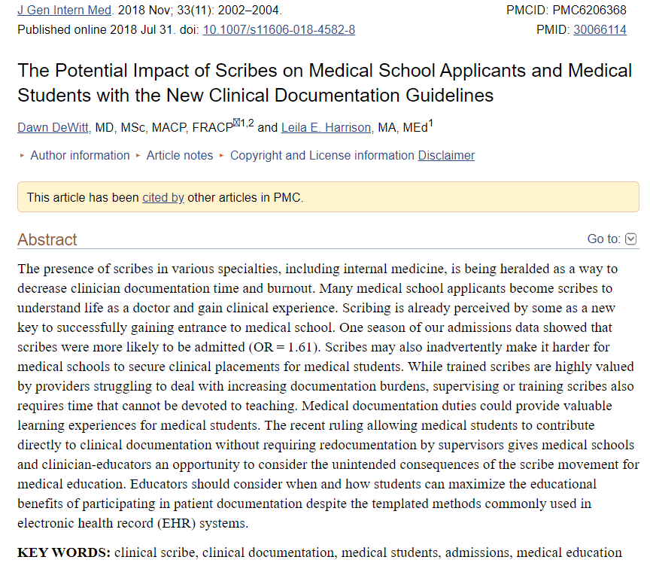
Notes:
Teaching students to obtain information and report it appropriately is a major goal of undergraduate medical education, and scribing can facilitate the achievement of some medical student milestones on the way to this goal – two examples are learning the appropriate use of medical vocabulary and the relative pertinence of information.
This paper which we’re citing from the Journal of General Internal Medicine suggests that the overuse of scribes is actually hampering the professional development of clerks, since their presence discourages them from engaging in roles of increasing responsibility for patience. Additionally, the time a supervisor spends reviewing scribe documentation could be spent reviewing that same documentation with a medical student, who we could argue has a more urgent need for that education.
Overall, we’d say that a greater inclusion of NMR and documentation training in clinical training, even outside of the pandemic, is really relevant and valuable. It just so happens that this large pool of idle students during the pandemic offers us an opportunity to test and transition that addition to the curriculum, with less risk of overworking clerks in the preliminary phase.
Approved by the Centre for Medicaid and Medicare Services, which is a program under the US Department of Health and Human Services in 2018. Previously, students were not allowed to be a part of the scribing process, since they’re technically not employed.

Slide 17
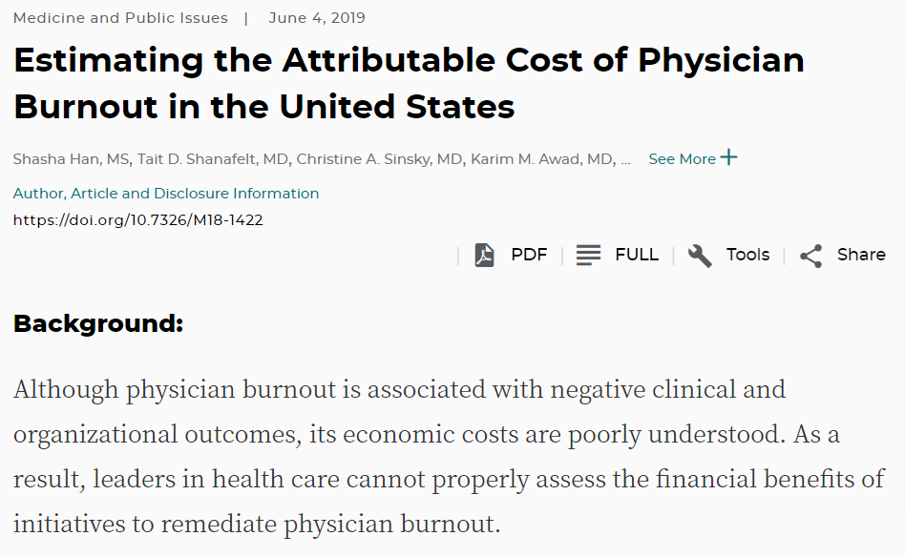
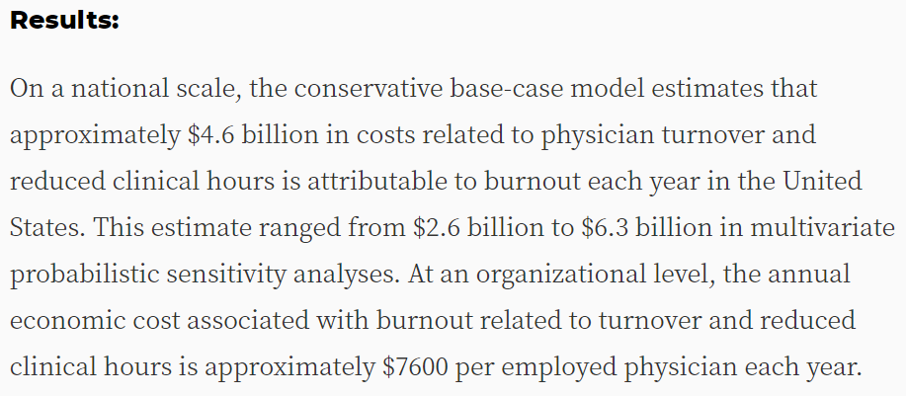

Slide 18
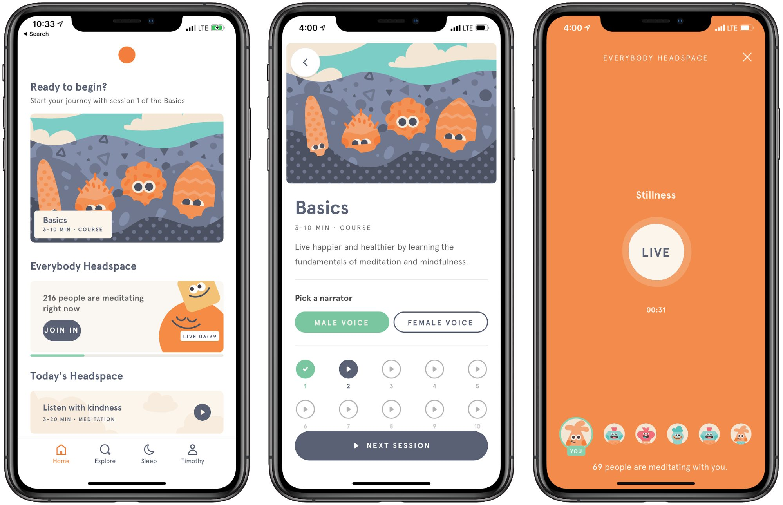

Example of E-Health Technology - Mindfulness and Meditation
Notes:
Assessing success
Talking about online mental health resources
More cost effective and anonymity aspect
Variety of resources
Have access to back-end data to assess efficacy of implemented mental health resources
Increase efficiency of future efforts by determining which kinds of resources staff are using (i.e., mindfulness and meditation, psychotherapy) and evaluate current efforst

